Slide 1
Operations Management
William J. Stevenson
8th edition

Slide 2
CHAPTER
6
Process Selection
and Facility Layout
Production Processes | Introduction to Business [Deprecated] (lumenlearning.com)
Operations Management, Eighth Edition, by William J. Stevenson
Copyright © 2005 by The McGraw-Hill Companies, Inc. All rights reserved.
McGraw-Hill/Irwin

Slide 3
In general do we have more no of variety in any production process or in any
Delivery.
Say for example – process of how to make a bread, steel, cement
Vs
How to teach a subject, how a vegetable vendor gives sells pitch

Slide 4
Introduction
Process selection
  Deciding on the way production of goods or services will be organized
Major implications
  Capacity planning
  Layout of facilities
  Equipment
  Design of work systems

Slide 5

Process Selection and System Design
Figure 6.1
Facilities and
Equipment
Forecasting
Capacity
Planning
Product and
Service Design
Layout
Process
Selection
Technological
Change
Work
Design

Slide 6
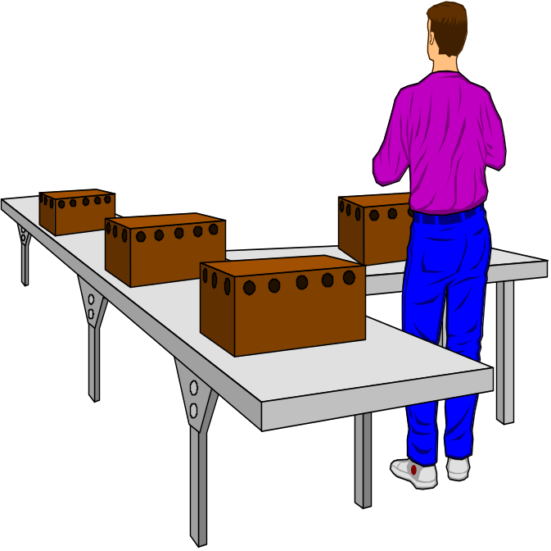
Process Strategy
Key aspects of process strategy
  Capital intensive – equipment/labor
  Process flexibility
  Adjust to changes
    Design
    Volume
    Technology

Slide 7

Process Selection
Variety
  How much
Flexibility
  What degree
Volume
  Expected output
  Depending on position of product life cycle , manager can shift from job process to batch and so on.
Batch
Job Shop
Repetitive
Continuous

Slide 8
Process Types
Job shop
  Small scale e.g- tool & dye shop, Veterinarian’s clinic.
Batch-(e.g) cookies, cake, movie theatre, paint ice cream, soft drink, beer, magazines, books.
  Moderate volume-
Repetitive/assembly line-TV/Pencil/PC/Autombl
  High volumes of standardized goods or services
Continuous-steel, sugar, salt, electricity supply
  Very high volumes of non-discrete goods

Slide 9
Product – Process Matrix
Figure 6.2
Process Type | Low Volume |  |  | High Volume
Job Shop | Appliance repair Emergency room |  |  | Not feasible
Batch |  | Commercial bakery Classroom Lecture
Repetitive |  |  | Automotive assembly Automatic carwash
Continuous (flow) | Not feasible |  |  | Oil refinery Water purification

Slide 10
Product – Process Matrix
Figure 6.2 (cont’d)
Dimension | Job Shop | Batch | Repetitive | Continuous
Job variety | Very High | Moderate | Low | Very low
Process flexibility | Very High | Moderate | Low | Very low
Unit cost | Very High | Moderate | Low | Very low
Volume of output | Very low | Low | High | Very high

Slide 11
Automation
Automation: Machinery that has sensing and control devices that enables it to operate
  Fixed automation
  Programmable automation
  Advantages- has low variability and this is good for quality and meeting schedules. Machines do not get bored/ distracted/ higher wages/strikes
  Disadv- may be expensive, effects moral & productivity, less flexibility.
  Fixed automation/ Programmable automation/Flexible.

Slide 12
Automation
Computer-aided design and manufacturing systems (CAD/CAM)
Numerically controlled (NC) machines – programmed to follow a set of processing instructions based on mathematical relationship. Best when frequent & batch process , closer tolerance required, mistake costly.
Robot
Flexible manufacturing systems(FMS)
Computer-integrated manufacturing (CIM)

Slide 13
Facilities Layout
Layout: the configuration of departments, work centers, and equipment, with particular emphasis on movement of work (customers or materials) through the system
The basic objectives of layout design is to facilitates a smooth flow of work, material & information through the system.

Slide 14
Importance of Layout Decisions
Requires substantial investments of money and effort
Involves long-term commitments
Has significant impact on cost and efficiency of short-term operations.

Slide 15


The Need for Layout Decisions
Inefficient operations
Changes in the design
of products or services
For Example:
High Cost
Bottlenecks
Accidents
The introduction of new
products or services
Safety hazards

Slide 16

The Need for Layout Design (Cont’d)
Changes in
environmental
or other legal
requirements
Changes in volume of
output or mix of
products
Morale problems
Changes in methods
and equipment

Slide 17
Basic Layout Types
Product layouts (In manufacturing engineering, a product layout refers to a production system where the work stations and equipment are located along the line of production, as with assembly lines. Usually, work units are moved along line (not necessarily a geometric line, but a set of interconnected work stations) by a conveyor)
Process layouts (Process layout is effected by way of arranging similar operations in a particular place. So under process layout, similar processes or equipment are grouped together. ... Process layout is suitable for non-repetitive or intermittent type of production) For example, a machine shop with mills located together, lathes located together, saws located together, and so on, is arranged with a process layout.
Fixed-Position layout
Combination layouts

Slide 18
Basic Layout Types
Product layout –car wash/ assembly line.
  Layout that uses standardized processing operations to achieve smooth, rapid, high-volume flow
Process layout- Hospital/colleges
  Layout that can handle varied processing requirements
Fixed Position layout-shipbuilding/aircraft
  Layout in which the product or project remains stationary, and workers, materials, and equipment are moved as needed

Slide 19
Product Layout
Figure 6.4
Raw materials
or customer
Station
1
Station
2
Station
3
Station
4
Finished item
Material
and/or labor
Material
and/or labor
Material
and/or labor
Material
and/or labor
Used for Repetitive or Continuous Processing

Slide 20
Product Layout
Figure 6.7 (cont’d)
Product Layout
(sequential)
Work
Station 1
Work
Station 2
Work
Station 3
Special purpose machines are used which perform the required function quickly and reliably. The product layout is selected when the volume of production of a product is high. Used for Repetitive Processing Repetitive or Continuous

Slide 21
A U-Shaped Production Line
Figure 6.6
In
1
2
3
4
5
Workers
6
Out
10
9
8
7

Slide 22
Advantages of Product Layout
High rate of output
Low unit cost
Labor specialization
Low material handling cost
High utilization of labor and equipment
Established routing and scheduling
Routing accounting and purchasing

Slide 23
Disadvantages of Product Layout
Creates dull, repetitive jobs
Poorly skilled workers may not maintain equipment or quality of output
Fairly inflexible to changes in volume
Highly susceptible to shutdowns
Needs preventive maintenance
Individual incentive plans are impractical

Slide 24
Process Layout
Figure 6.7
Process Layout
(functional)
Dept. A
Dept. C
Dept. E
Dept. B
Dept. D
Dept. F
Process layout is recommended for batch production. All machines performing similar type of operations are grouped at one location in the process layout e.g., all lathes, milling machines, etc. are grouped in the shop will be clustered in like groups. Used for Intermittent processing Job Shop or Batch

Slide 25
Advantages of Process Layouts
Can handle a variety of processing requirements
Not particularly vulnerable to equipment failures
Equipment used is less costly
Possible to use individual incentive plans

Slide 26
Disadvantages of Process Layouts
In-process inventory costs can be high
Challenging routing and scheduling
Equipment utilization rates are low
Material handling slow and inefficient
Complexities often reduce span of supervision
Special attention for each product or customer
Accounting and purchasing are more involved

Slide 27
Cellular /Combination Layouts
  Layout in which machines are grouped into a cell that can process items that have similar processing requirements,
  A combination of process and product layouts combines the advantages of both types of layouts. A combination layout is possible where an item is being made in different types and sizes. Here machinery is arranged in a process layout but the process grouping is then arranged in a sequence to manufacture various types and sizes of products. It is to be noted that the sequence of operations remains same with the variety of products and sizes

Slide 28
Functional vs. Cellular Layouts
Table 6.3
Dimension | Functional | Cellular
Number of moves between departments | many | few
Travel distances | longer | shorter
Travel paths | variable | fixed
Job waiting times | greater | shorter
Throughput time | higher | lower
Amount of work in process | higher | lower
Supervision difficulty | higher | lower
Scheduling complexity | higher | lower
Equipment utilization | lower | higher

Slide 29
Other Service Layouts
Warehouse and storage layouts
Retail layouts
Office layouts

Slide 30
Design Product Layouts: Line Balancing
Line Balancing is the process of assigning
tasks to workstations in such a way that the workstations have approximately
equal time requirements.

Slide 31
Cycle Time
Cycle time is the maximum time
allowed at each workstation to
complete its set of tasks on a unit.

Slide 32
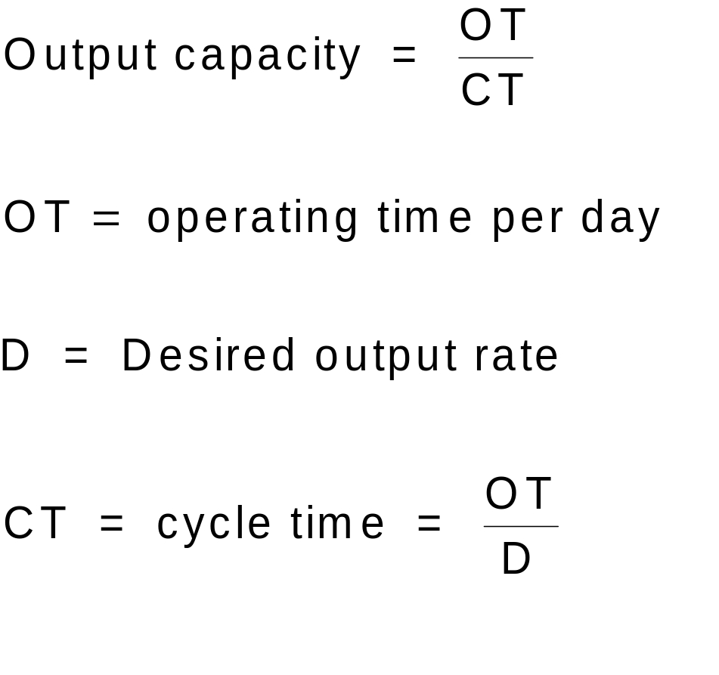
Determine Maximum Output

Slide 33
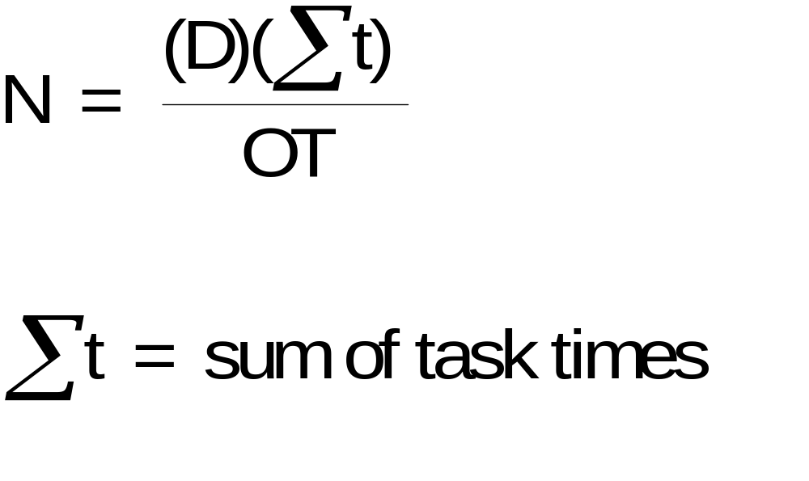
Determine the Minimum Number of Workstations Required

Slide 34
Precedence Diagram
Figure 6.10
Precedence diagram: Tool used in line balancing to display elemental tasks and sequence requirements
0.1 min.
1.0 min.
A Simple Precedence
Diagram
a
b
c
d
e
0.7 min.
0.5 min.
0.2 min.

Slide 35
Example 1: Assembly Line Balancing
Arrange tasks shown in Figure 6.10 into three workstations.
  Use a cycle time of 1.0 minute
  Assign tasks in order of the most number of followers

Slide 36
Example 1 Solution
Workstation | Time Remaining | Eligible | Assign Task | Revised Time Remaining | Station Idle Time
1 | 1.0 0.9 0.2 | a, c c none | a c - | 0.9 0.2 | 0.2
2 | 1.0 | b | b | 0.0 | 0.0
3 | 1.0 0.5 0.3 | d e - | d e - | 0.5 0.3 | 0.3 0.5

Slide 37

Calculate Percent Idle Time
Efficiency = 1 – Percent idle time

Slide 38
Line Balancing Rules
Some Heuristic (intuitive) Rules:
Assign tasks in order of most following tasks.
  Count the number of tasks that follow
Assign tasks in order of greatest positional weight.
  Positional weight is the sum of each task’s time and the times of all following tasks.

Slide 39
Example 2
0.2
0.2
0.3
a
b
e
0.8
0.6
c
d
f
g
h
1.0
0.4
0.3

Slide 40
Solution to Example 2
Station 1
Station 2
Station 3
Station 4
a
b
e
f
g
h
c
d

Slide 41
Parallel Workstations
1 min.
30/hr.
1 min.
30/hr.
2 min.
30/hr.
1 min.
30/hr.
Bottleneck
30/hr.
1 min.
30/hr.
1 min.
60/hr.
1 min.
1 min.
60/hr.
30/hr.
1 min.
30/hr.
Parallel Workstations

Slide 42
Designing Process Layouts
Information Requirements:
List of departments
Projection of work flows
Distance between locations
Amount of money to be invested
List of special considerations
Location of key utilities

Slide 43
Example 3: Interdepartmental Work Flows for Assigned Departments
Figure 6.12
30
170
100
1
3
2
A
B
C

Slide 44
Author’s note:
  The following three slides are not in the 8e, but I like to use them for alternate examples.

Slide 45
Process Layout
Milling
Assembly
& Test
Grinding
Drilling
Plating
Process Layout - work travels
to dedicated process centers

Slide 46
Functional Layout
222
222
222
Mill
111
Drill
Grind
444
22222
3333
444
1111
2222
Assembly
111
333
333333333
44444
333333
111
111
Heat
treat
Gear
cutting
Lathes
111
333
444

Slide 47
Cellular Manufacturing Layout
Heat
treat
Gear
cut
-1111
Lathe
Mill
Drill
-1111
Heat
treat
222222222
Mill
Drill
Grind
- 2222
Assembly
Heat
treat
- 3333
3333333333
Lathe
Mill
Grind
44444444444444
Mill
Drill
Gear
cut
- 4444

